Slide 1

Inpatient Evaluation of Acute Dyspnea
Objectives
1. Develop a broad differential for causes of acute dyspnea
2. Construct a framework for the evaluation of acute dyspnea
3. Identify causes of acute hypoxemia
PRACTICE CASES

Slide 2

1. Causes of Acute Dyspnea
Airways
Anaphylaxis, angioedema
Mucus plugging, airway stenosis
Click to reveal differential
Bronchoconstriction (COPD, asthma)
RESPIRATORY
Alveoli
Fills alveoli
Collapses alveoli
Click here
Blockage or narrowing of any part of the respiratory system will cause dyspnea!
Blood = DAH
Pus = pneumonia
Water = edema
Atelectasis
Pleural process (blood, pus, water, air)
Vessels
Pulmonary embolism
Diaphragm dysfunction
Abdominal pressure
MUSCULOSKELETAL
Myocardial infarction
Arrhythmias
Valvular disease
Pericardial disease
CARDIAC
Anxiety
Acidosis (metabolic and respiratory)
Anemia
The 3 “A’s”
2 EVAL
3 HYPOXEMIA

Slide 3
2. Evaluation and Diagnostics
How to Evaluate
Airways
Anaphylaxis, angioedema
Physical exam
Mucus plugging, airway stenosis
Bronchoconstriction (COPD, asthma)
Alveoli
Fills alveoli
Collapses alveoli
CXR
Blood = DAH
Pus = pneumonia
Water = edema
Atelectasis
Pleural process (blood, pus, water, air)
Vessels
ABG
Pulmonary embolism
CTPE
Diaphragm dysfunction
Abdominal pressure
CXR, ABG/ VBG
Physical exam
Myocardial infarction
Arrhythmias
Valvular disease
ECG
Pericardial disease
Physical exam
Anxiety
Acidosis (metabolic and respiratory)
Anemia
BMP, ABG/ VBG
1 CAUSES
3 HYPOXEMIA
CBC
More Eval

Slide 4
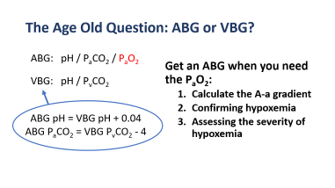

2. Evaluation and Diagnostics
Airways
Anaphylaxis, angioedema
Physical exam
Mucus plugging, airway stenosis
Bronchoconstriction (COPD, asthma)
Important diagnostic tests:
CXR
ECG
CBC
Alveoli
Fills alveoli
Collapses alveoli
CXR
Blood = DAH
Pus = pneumonia
Water = edema
Atelectasis
Pleural process (blood, pus, water, air)
ABG vs. VBG
Vessels
ABG
Pulmonary embolism
CTPE
Diaphragm dysfunction
Abdominal pressure
CXR, ABG/ VBG
Physical exam
Myocardial infarction
Arrhythmias
Valvular disease
ECG
Pericardial disease
Physical exam
Anxiety
Acidosis (metabolic and respiratory)
Anemia
BMP, ABG/ VBG
1 CAUSES
3 HYPOXEMIA
CBC

Slide 5

3. Hypoxemia
O₂
Dyspnea ≠ Hypoxemia
O₂
Alveoli
PaO₂ is measured on an ABG.
Normal PaO₂ is 75 -100.
Hypoxemia = low PaO₂
Not all causes of dyspnea cause hypoxemia.
O₂
O₂ diffuses from the alveoli across lung parenchyma into the capillaries where it dissolves. The concentration or partial pressure O₂ in our arterioles is the PaO₂.
Lung parenchyma
PaO₂
Capillary
Click Anywhere to Advance Slide Animations and Text
1 CAUSES
2 EVAL

Slide 6
Causes of Hypoxemia
There are 5 causes of hypoxemia. They can be differentiated between those that cause an ↑ A-a gradient and those that do not. Click to learn more about the A-a gradient.
P_{A}O₂
Alveoli
↓ FiO₂
Click here first
O₂
Normal A-a gradient
O₂
Hypoventilation
Lung parenchyma
V/Q mismatch
O₂
PaO₂
Capillary
Shunt
↑ A-a gradient
↓ diffusion capacity
The A-a gradient = P_{A}O₂ – PaO₂
P_{A}O₂ = FiO₂ x (P_{atm} – P_{H2O}) – P_{a}CO₂ (1.25)
PaO₂ and PCO₂ are obtained from an ABG
The expected A-a gradient = age / 4 + 4
A-a gradient is the difference in the P_{A}O₂ alveolar O₂) and PaO₂ (arterial O₂). There is normally minimal difference because there are few barriers to diffusion. Click on ↓ FiO₂
or Hypoventilation for additional information.
An elevated A-a gradient occurs when there is a disruption in the alveolar-capillary unit. Pathology in the alveoli (aka ventilation), lung parenchyma or capillaries (aka perfusion) can result in hypoxemia with an elevated A-a gradient.
1 CAUSES
2 EVAL
3 HYPOXEMIA

Slide 7
Decreased FiO₂
P_{A}O₂
Alveoli
↓ FiO₂
O₂
O₂
Hypoventilation
Lung parenchyma
V/Q mismatch
O₂
PaO₂
Capillary
Shunt
Decreased FiO₂ typically occurs at higher altitudes. The lower the fractional inspired concentration of O₂, the less O₂ is available to diffuse into capillaries resulting in lower PaO₂.
Clinically, this does not occur acutely and is not a cause of hypoxemia in the hospital.
↓ diffusion capacity
1 CAUSES
2 EVAL
3 HYPOXEMIA

Slide 8
Hypoventilation
P_{A}O₂
Alveoli
↓ FiO₂
O₂
CO₂
O₂
Hypoventilation
Lung parenchyma
V/Q mismatch
O₂
CO₂
PaO₂
CO₂
Capillary
Shunt
Ventilation, which is determined by respiratory rate and tidal volume (volume of breaths) creates opportunities for gas exchange. Hypoventilation ↓ elimination of CO₂ resulting in ↑ PCO₂. Elevated PCO₂ effectively ↓ “space” for O2, and subsequently results in hypoxemia. Examples include CNS depression, opiates/ benzodiazepines, neuromuscular weakness, diaphragmatic dysfunction.
↓ diffusion capacity
1 CAUSES
2 EVAL
3 HYPOXEMIA

Slide 9
V/Q mismatch
O₂
O₂
P_{A}O₂
Alveoli
↓ FiO₂
V
O₂
Hypoventilation
Lung parenchyma
V/Q mismatch
Q
PaO₂
Capillary
Shunt
Ventilation (V) - Perfusion (Q) mismatch (or V/Q mismatch) occurs when there are areas of V without Q or vice versa. This can occur in the presence of smaller alveolar filling/collapsing process, obstructive airway disease, pulmonary vascular disease, or pulmonary embolism.
↓ diffusion capacity
1 CAUSES
2 EVAL
3 HYPOXEMIA

Slide 10
Shunt
O₂
Hypoxemia that does not correct with 100% O₂ suggests a large shunt.
O₂
O₂
P_{A}O₂
Alveoli
↓ FiO₂
V
Hypoventilation
Lung parenchyma
V/Q mismatch
Q
PaO₂
Capillary
Shunt
Shunt occurs when there is perfusion (Q) without ventilation (V). This can occur in the presence of a physical shunt or with a large alveolar filling/collapsing process. Things that fill the alveoli include blood, water, pus.
↓ diffusion capacity
1 CAUSES
2 EVAL
3 HYPOXEMIA

Slide 11
Decreased diffusion capacity
P_{A}O₂
Alveoli
↓ FiO₂
O₂
O₂
Hypoventilation
Lung parenchyma
V/Q mismatch
O₂
Shunt
PaO₂
Capillary
↓ diffusion capacity
Decreased diffusion capacity can occur when there is pathology in the lung parenchyma such as with interstitial lung disease/ lung fibrosis. This does not happen acutely and is unlikely a cause of acute dyspnea in the hospital.
1 CAUSES
2 EVAL
3 HYPOXEMIA
CASES

Slide 12

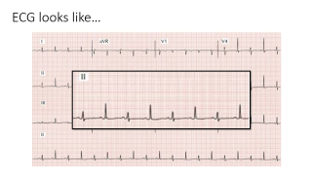
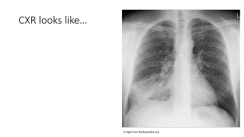
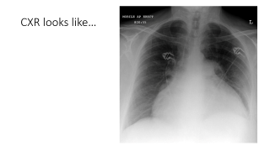
CASE 1
CASE 2
CASE 3
84 M with a history of HLD, CAD presents with 1 d of dyspnea.
VS: T 38C, HR 110, BP 125/70, RR 24, S_{a}O₂ 92% on RA
Exam:
Tachycardic, regular rhythm, no murmurs
Crackles in the R lower lung fields
74 F with a history of NHL presents with 1 d of dyspnea.
VS: T 36C, HR 110, BP 98/60, RR 24, S_{a}O₂ 94% on RA
Exam:
Tachycardic, regular rhythm, elevated JVP
Lungs clear
25 F with type 1 DM a presents with 1 d of dyspnea.
VS: T 36C, HR 110, BP 125/70, RR 32, S_{a}O₂ 99% on RA
Exam:
Tachycardic, regular rhythm
Tachypneic without increased work of breathing, clear lungs
Diagnostic testing
Diagnostic testing
Diagnostic testing
CXR is clear.
Focal abnormalities on lung exam should prompt a CXR.
CXR here shows a boot shaped heart which could indicate cardiomegaly or pleural effusion.
CXR
CXR
CXR
BMP showed Na of 128, K 4.5, HCO3 8, BUN 32, Cr 2.2. CBC showed a WBC of 12.5k, Hgb 10.2.
BMP was wnl. CBC showed a WBC of 9.5k, Hgb 10.2.
BMP/ CBC
BMP was wnl. CBC showed a WBC of 13.5k, Hgb 10.2.
BMP/ CBC
BMP/ CBC
VBG: 7.1/29/-/9. There are no concerns about hypoxemia so a VBG is sufficient in this case.
A blood gas is likely not needed in this case. ABG shows 7.48/32/65/22.
A blood gas is likely not needed in this case. ABG shows 7.48/32/86/22.
ABG/ VBG
ABG/ VBG
ABG/ VBG
ECG shows sinus tachycardia and nonspecific T wave changes.
ECG shows sinus tachycardia without signs of ischemia.
ECG shows signs of electrical alternans, which can be seen in pleural effusion.
ECG
ECG
ECG
Dyspnea and tachypnea from respiratory compensation of severe metabolic acidosis (DKA)
Dyspnea and hypoxemia 2/2 to RLL pneumonia.
In the context of hypotension, elevated JVP, and pericardial effusion, she likely has tamponade.
FINAL DIAGNOSIS
FINAL DIAGNOSIS
FINAL DIAGNOSIS

Slide 13
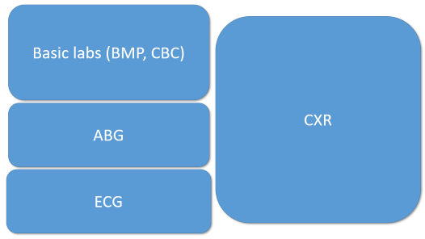
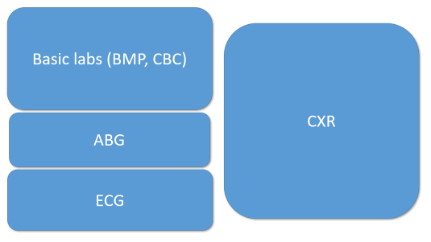
CASE 4 (part 1)
CASE 4 (part 2)
64 M with a history of R-sided renal cell cancer admitted for a R nephrectomy.
On post-op day 1, he developed acute onset shortness of breath and chest and abdominal pain.
VS: T 37.1C, HR 140, BP 90/60, RR 28, S_{a}O₂ 96% on RA
Tachypneic, diminished lung sounds at bases. Abdomen distended and tender
On post-op day 5, he developed acute onset shortness of breath and chest pain.
VS: T 37.1C, HR 140, BP 90/60, RR 28, S_{a}O₂ 82% on RA
Tachypneic, lungs otherwise clear. Tachycardic without murmurs.
FINAL DIAGNOSIS
BMP and CBC are wnl. CXR: clear lung fields, ECG: sinus tachycardia. ABG shows evidence of hypoxemia (PaO₂) with an elevated A-a gradient (click for A-a gradient calculation).
The most likely etiology here of elevated A-a gradient (click for differential) is V/Q mismatch. In the presence of a normal CXR, this is likely a PE.
FINAL DIAGNOSIS
CXR: low lung fields, ECG: sinus tachycardia. ABG: normal without hypoxemia. CBC shows severe drop in hct. This is dyspnea 2/2 to severe anemia likely from post-op bleeding.

Slide 14
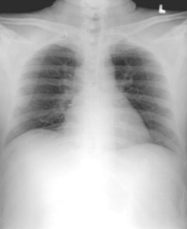
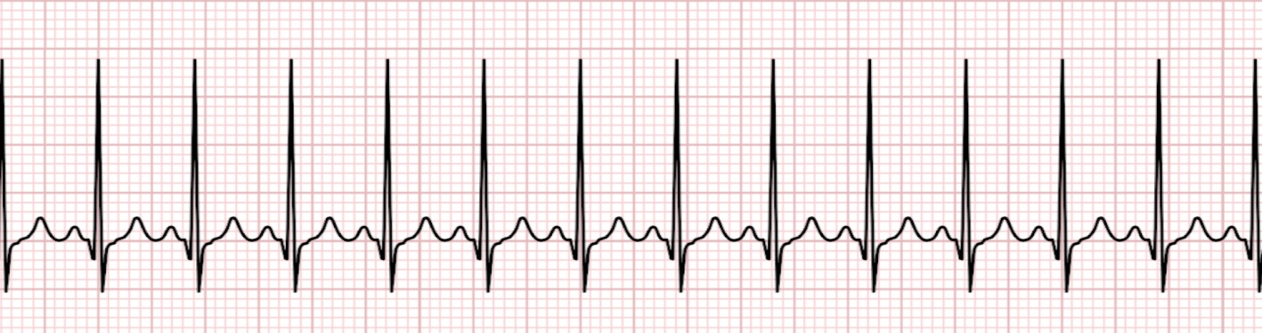
Basic labs (BMP, CBC)
140
98
12
112
CXR
4
24
1.0
9.8
5.8
9
350
14
350
30
19
ABG
ABG: pH 7.43
PCO₂ 45
PO₂ 80
HCO₃ 24
ECG

Slide 15
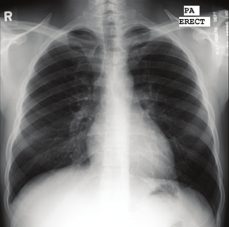
Basic labs (BMP, CBC)
140
98
12
CXR
112
4
24
1.0
14
9
350
42
ABG
ABG: pH 7.43
PCO₂ 32
PO₂ 50
HCO₃ 24
ECG

Slide 16
GO BACK
Calculate the A-a gradient
pH 7.43 / PCO₂ 32/ PO₂ 50 / HCO₃ 24 (on room air)
Calculate an A-a gradient!
P_{A}O₂ = 150 – 32 x (1.25)
P_{A}O₂ = 110
P_{A}O₂ - P_{a}O₂ = 110 – 50 = 60
Expected A-a gradient = Age/4 + 4
= 64/4 + 4
= 20
Elevated A-a gradient!

Slide 17
GO BACK
Causes of an elevated A-a gradient
Non-anatomic shunts are evident on CXR
Alveoli
V
Shunt (anatomic, large alveolar filling process)
V/Q mismatch (obstructive lung disease, pulmonary vascular disease/PE)
↓ diffusion capacity
Lung parenchyma
Q
Capillary
Does not typically happen acutely

Slide 18
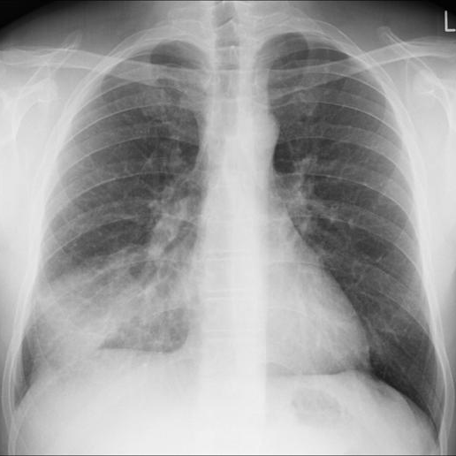
CXR looks like…
GO BACK
Image from Radiopaedia.org

Slide 19
The Age Old Question: ABG or VBG?
GO BACK
ABG: pH / P_{a}CO₂ / P_{a}O₂
Get an ABG when you need the P_{a}O₂:
Calculate the A-a gradient
Confirming hypoxemia
Assessing the severity of hypoxemia
VBG: pH / P_{v}CO₂
ABG pH = VBG pH + 0.04
ABG P_{a}CO₂ = VBG P_{v}CO₂ - 4

Slide 20
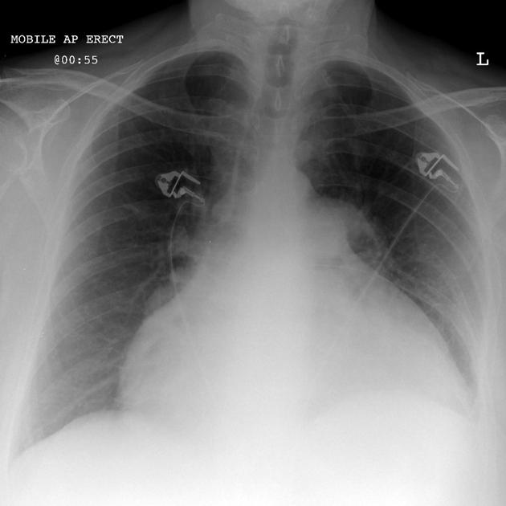
CXR looks like…
GO BACK

Slide 21
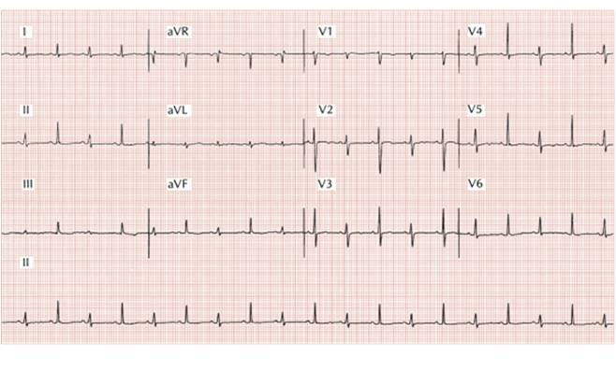
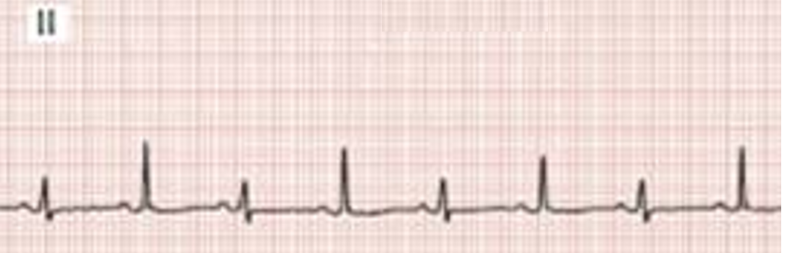
ECG looks like…
GO BACK

